Slide 1
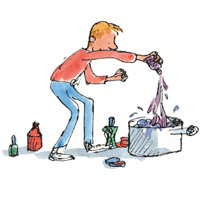
Welcome to Dahl Class
Parent Information Presentation

Slide 2
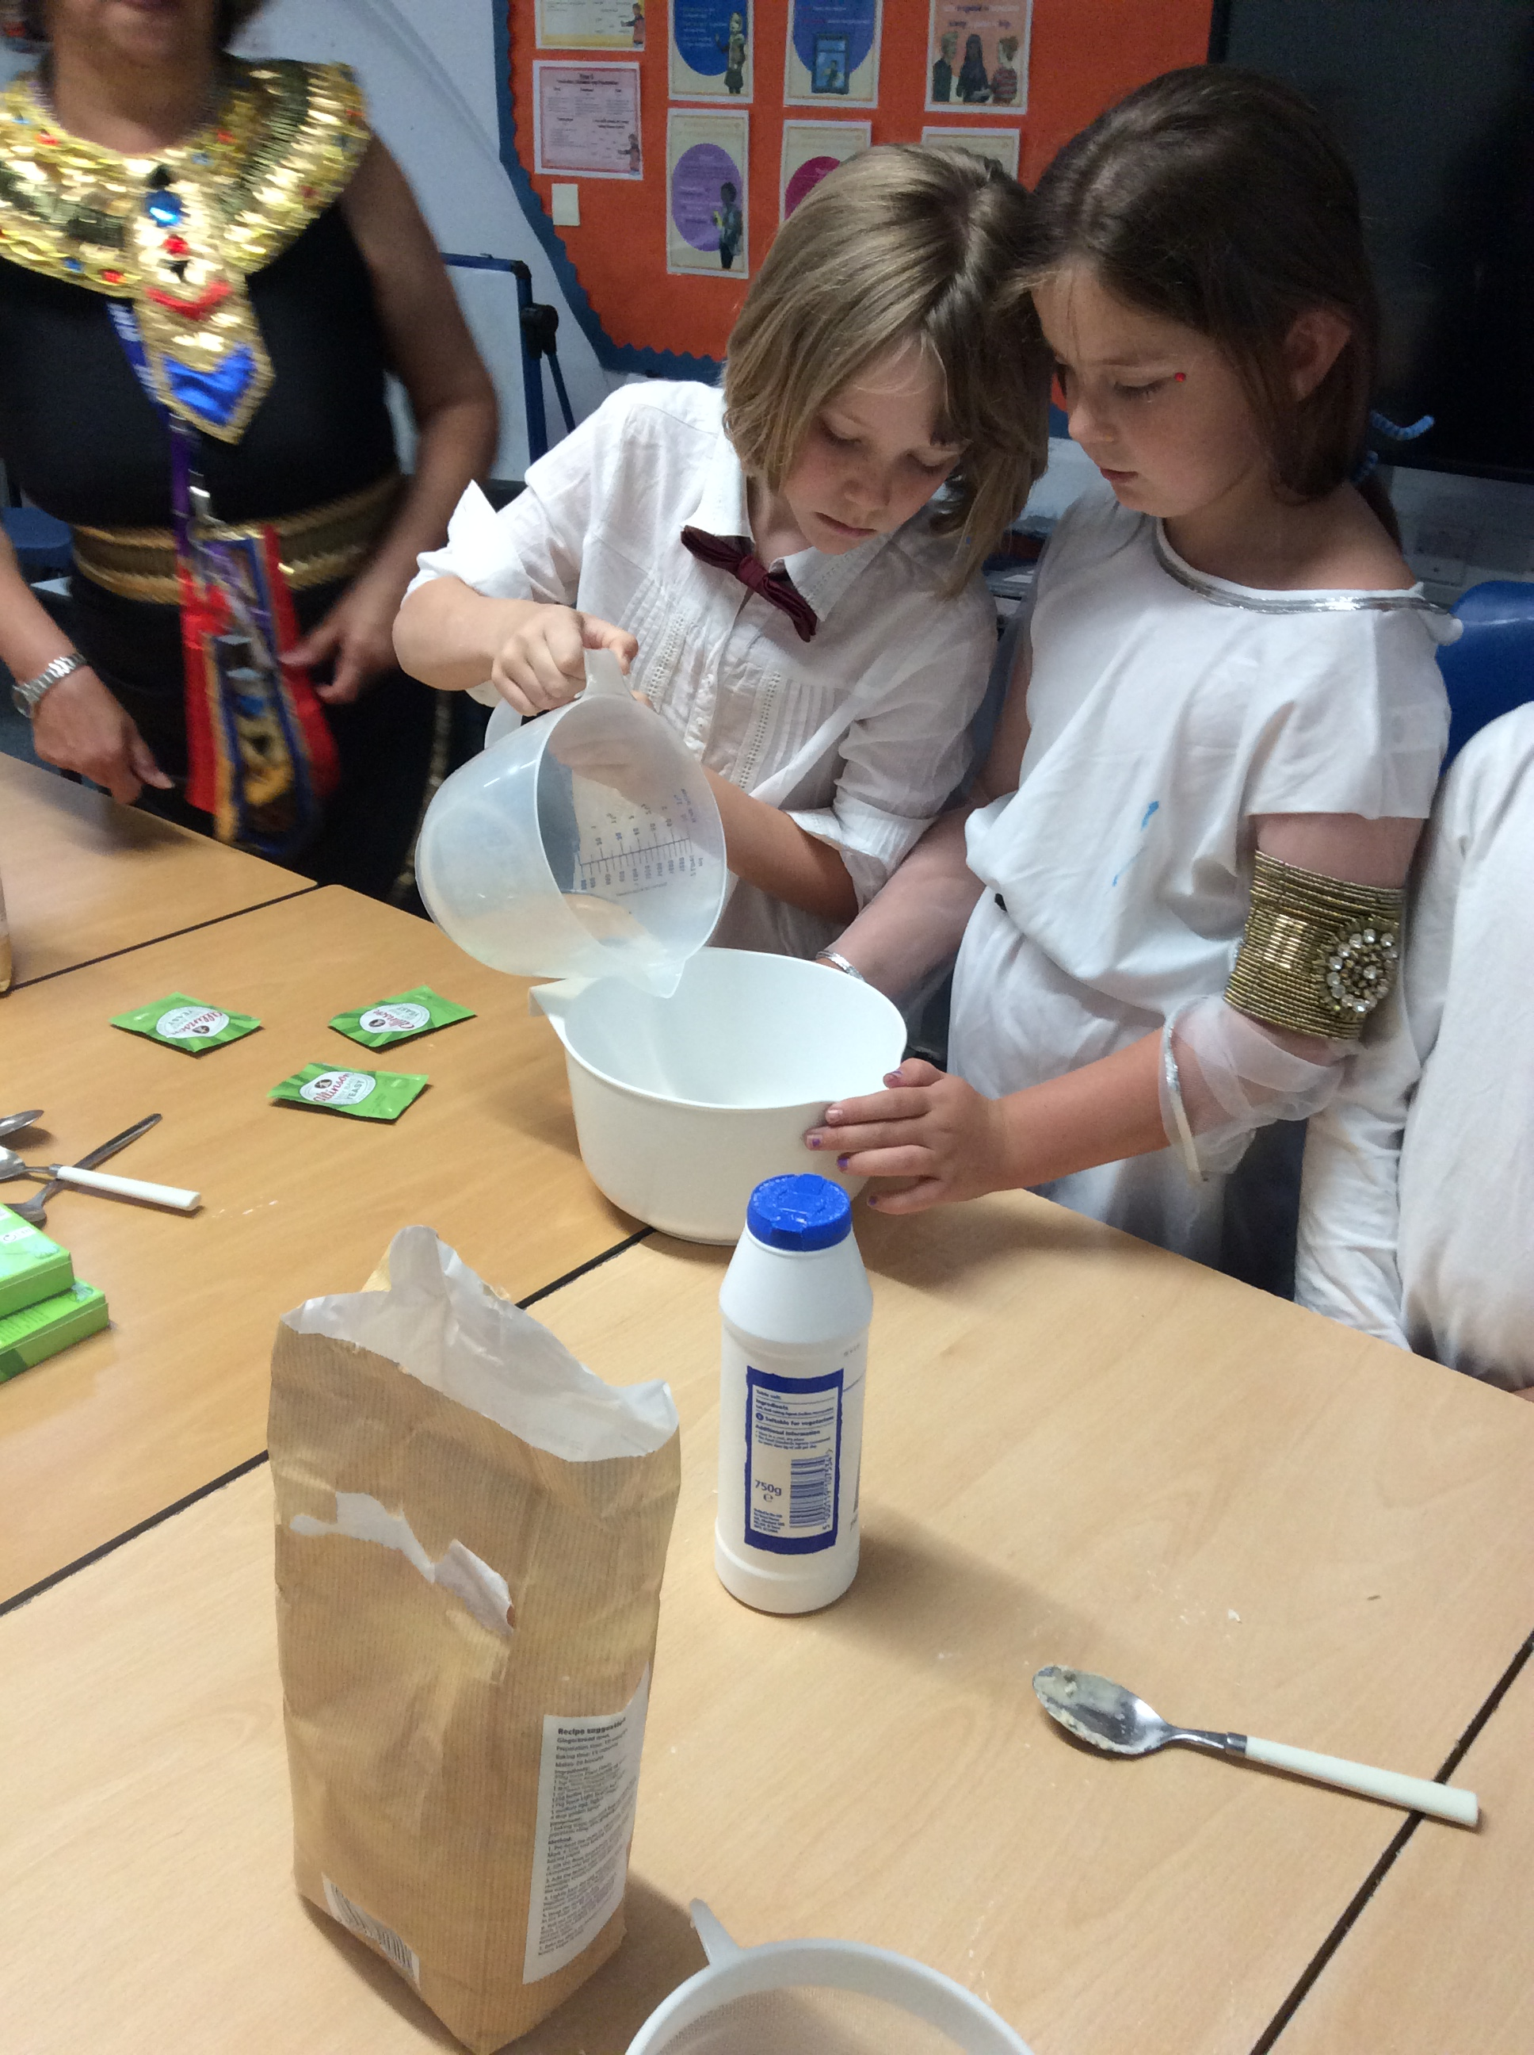
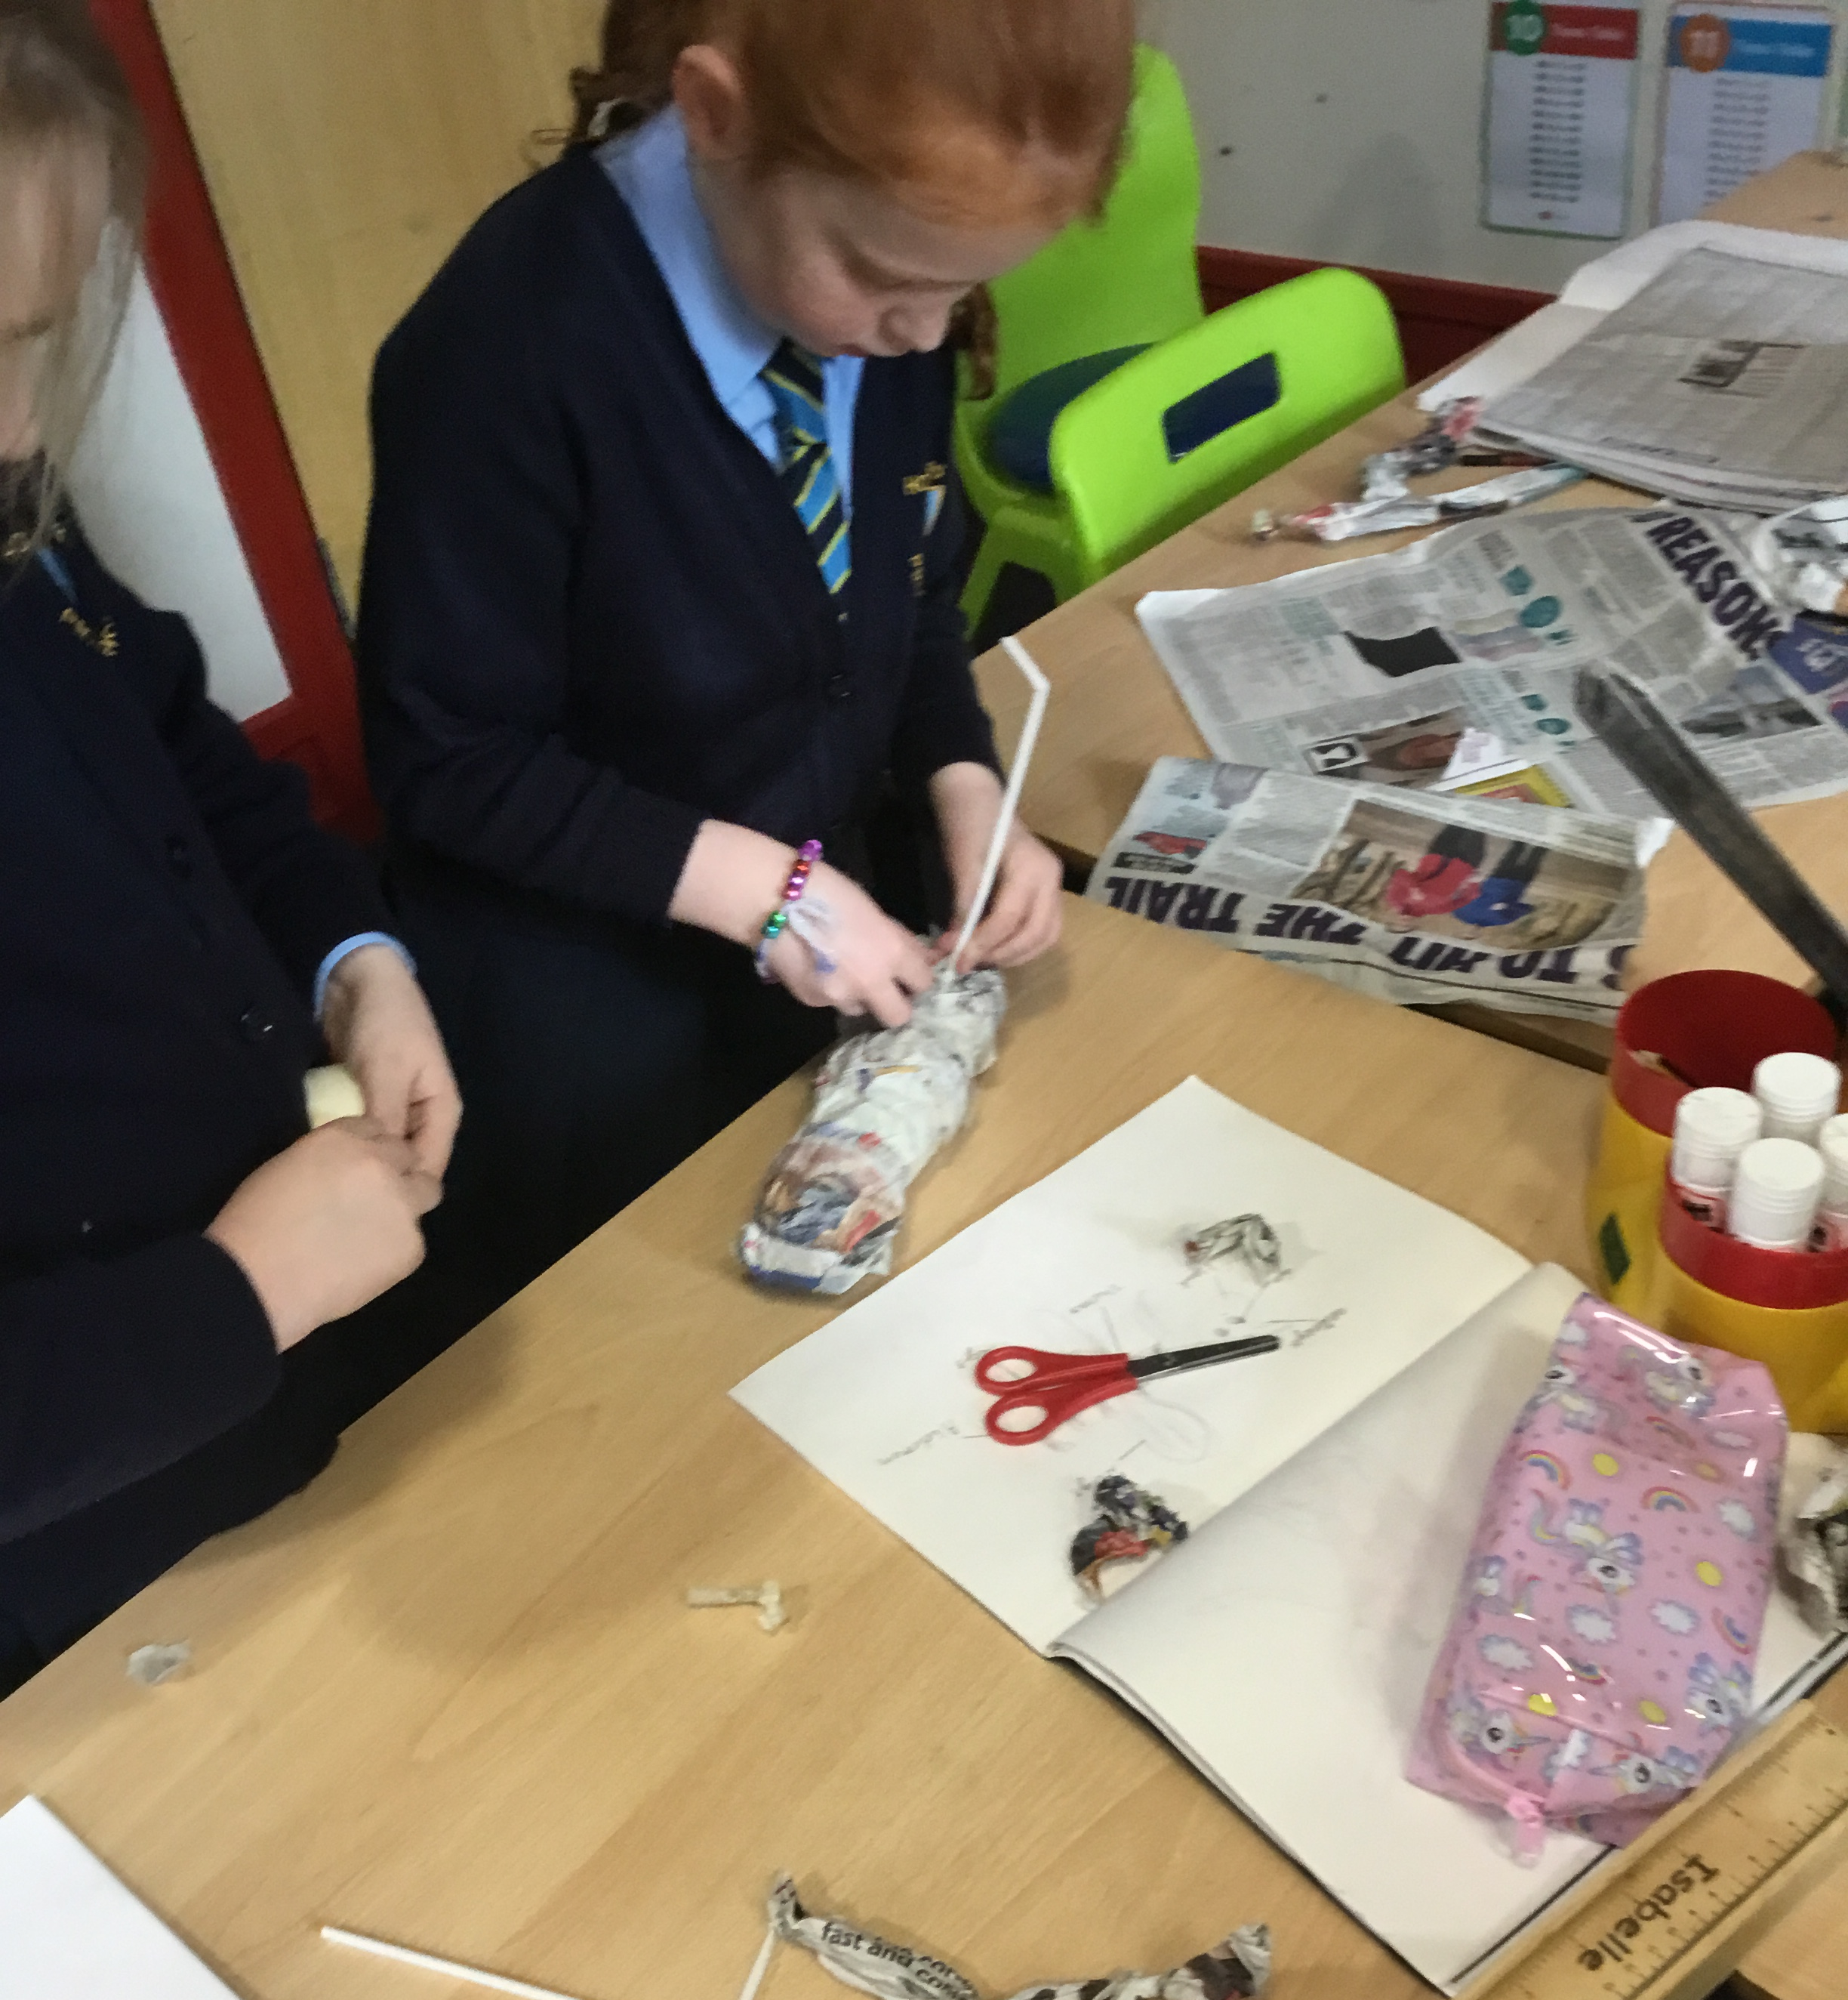
The School Day
08:30 – 08:50 – School begins (Early morning learning time) 08:50 – 09:00 - Registration
09:00 – 09:20 – RWI Phonics/Spellings
09:20 - 10:00 - Reading
10:00 - 10:45 - Writing
10:45 – 11:00 – Break
11:00 – 12:00 - Maths
12:00 - 12:15 Mental Maths
12:15 – 13:00 – Lunch
13:05 – 15:00 – Afternoon sessions
15:00 – 15:15 – Whole class story
15:15 – School ends

Slide 3
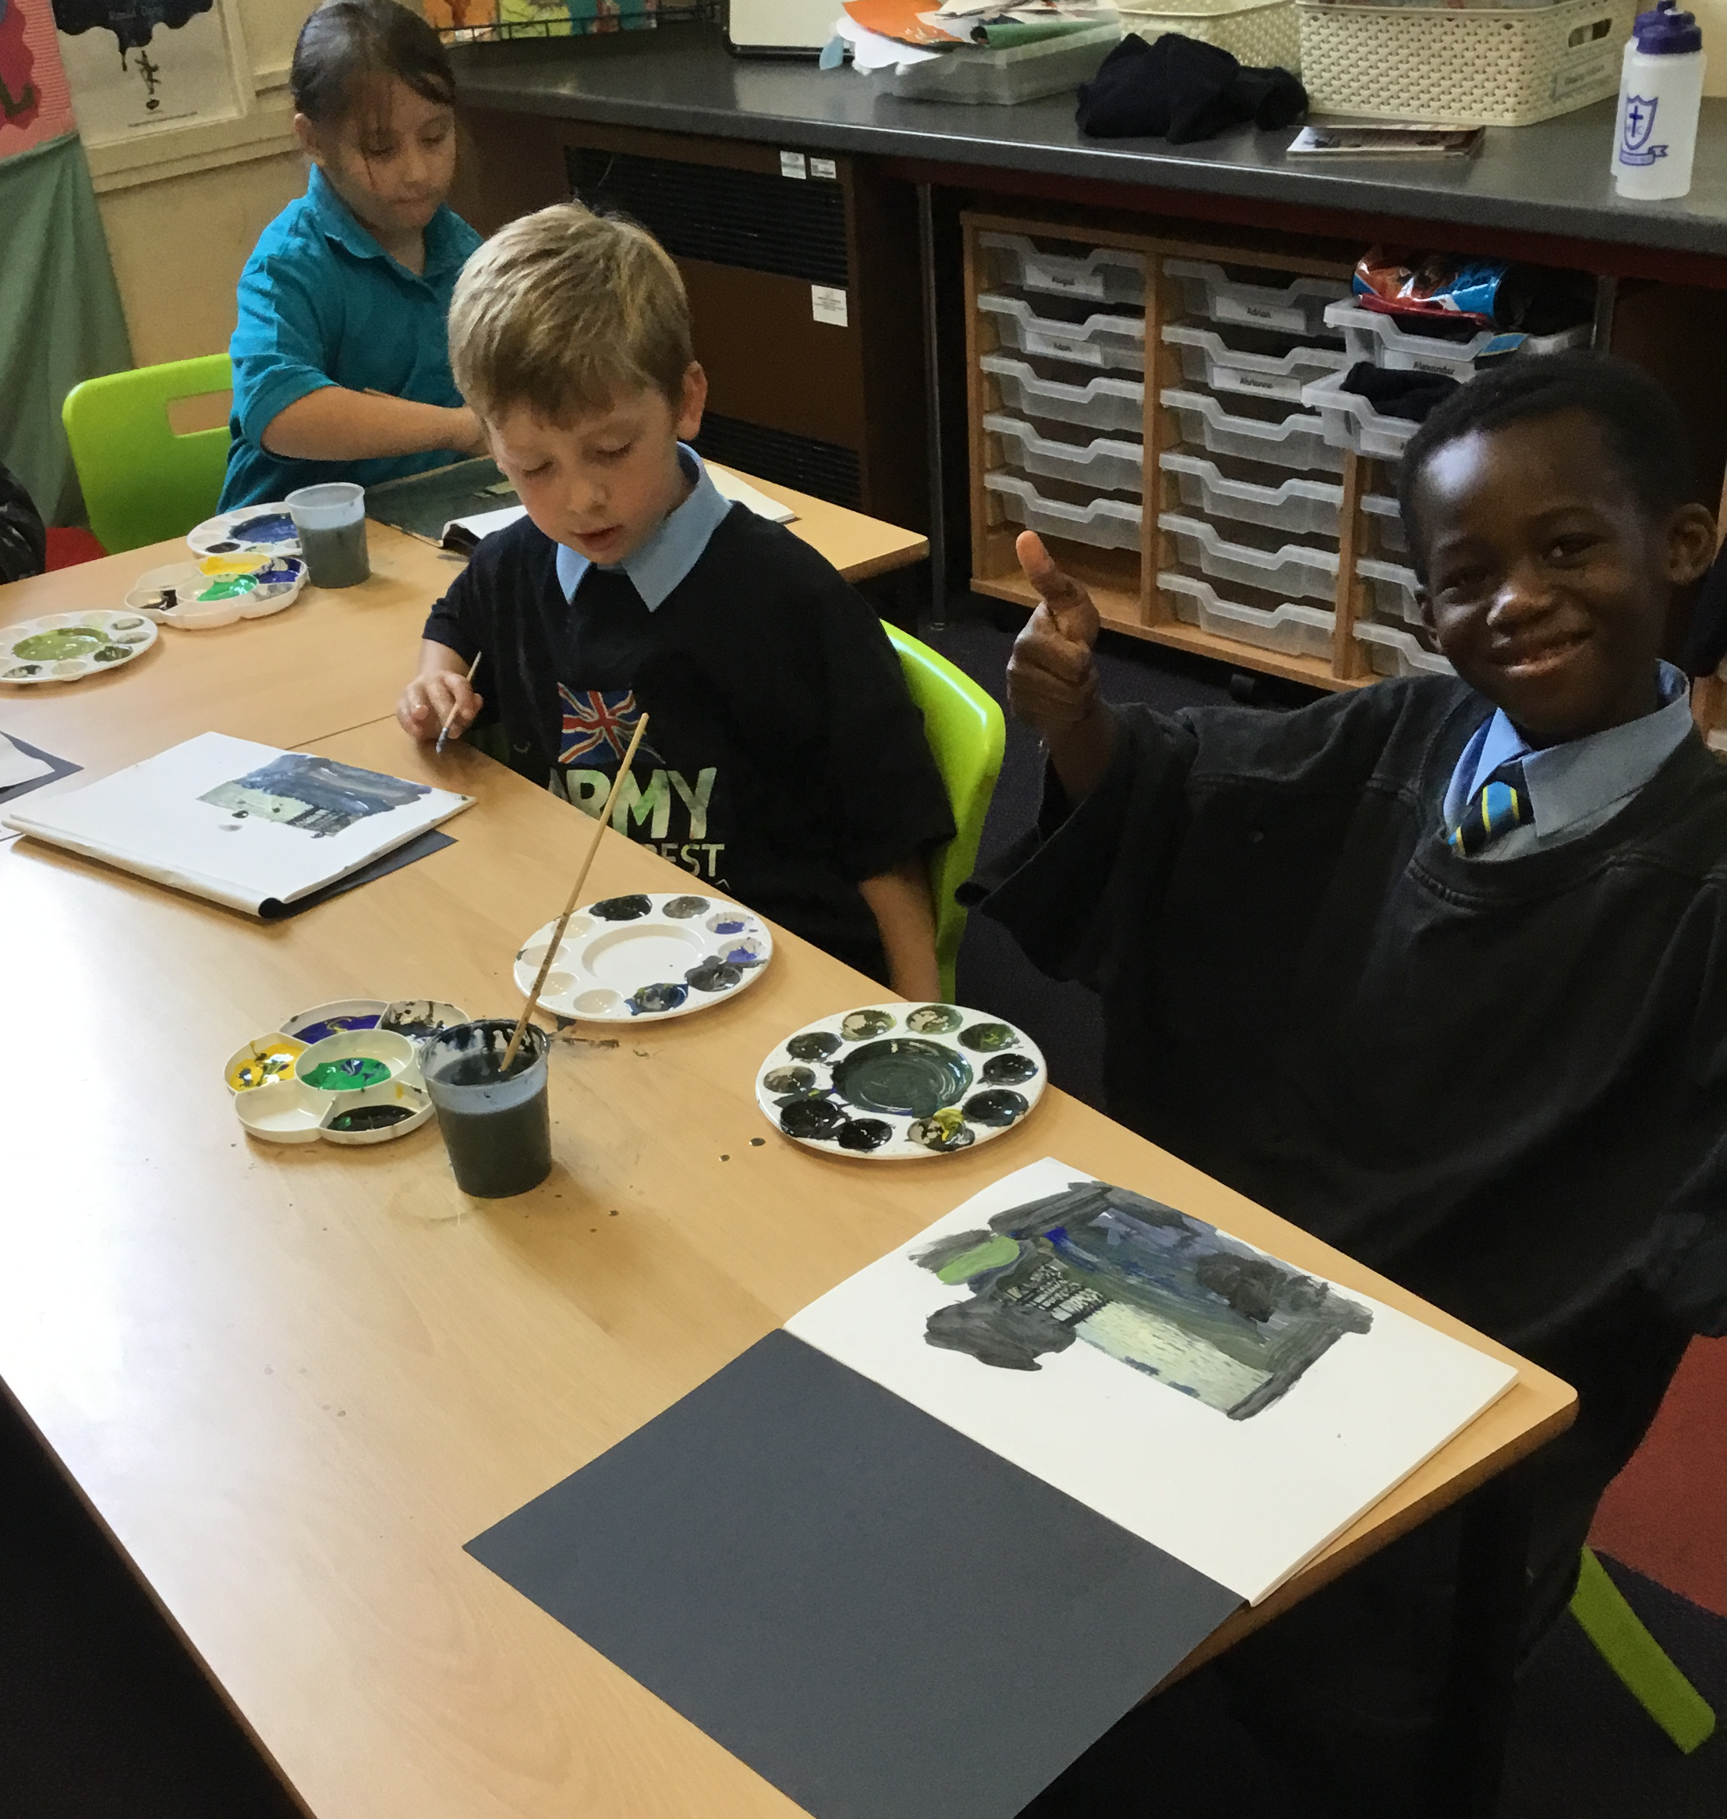
The Curriculum
English | Cassia’s War - warning tale
Maths | Place value, times tables, ordering and comparing numbers, adding and subtracting 3 digit numbers.
RE | Creation and Prayers, Feasts and Saints
Science | Forces and magnets
Topic | Romans
Design Technology | Juggling balls
PE | Roman dance
French | All about town
Music | Recognise how musical elements can be used together to compose descriptive music. Combine sounds with movement and narrative.
Autumn Term 1

Slide 4
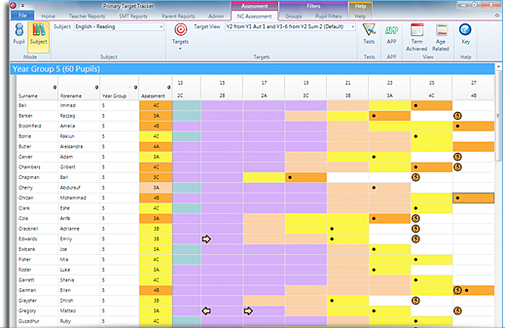
Monitoring
Starting a new class can be daunting for the children and the parents! Please know that we will care and look after your child and will do everything possible to ensure that they have a wonderful time in Dahl Class and achieve their full potential. How do we do this?
-Pupil progress meetings (every 6 weeks)
-Weekly key stage meetings (moderation and support)
-Daily class meetings (Teachers and TAs discussing the day to come)
-Academic and behaviour tracking systems
-Open lines of communication

Slide 5
Home/School
Partnership
•Sit comfortably and limit distractions.
•When listening, don’t rush to correct mistakes unless it significantly alters meaning.
•Characterisation – put on voices to make them come to life.
•After reading discuss what has been read. Ask questions about events, characters and predict what might happen next.
•Ask your child to make comparisons within the book and with other books
•Always praise and comment on progress.
•Read to them yourself and communicate your own enjoyment.
•Read with a dictionary to support reading as writers.
•Model being a reader yourself.
Reading

Slide 6
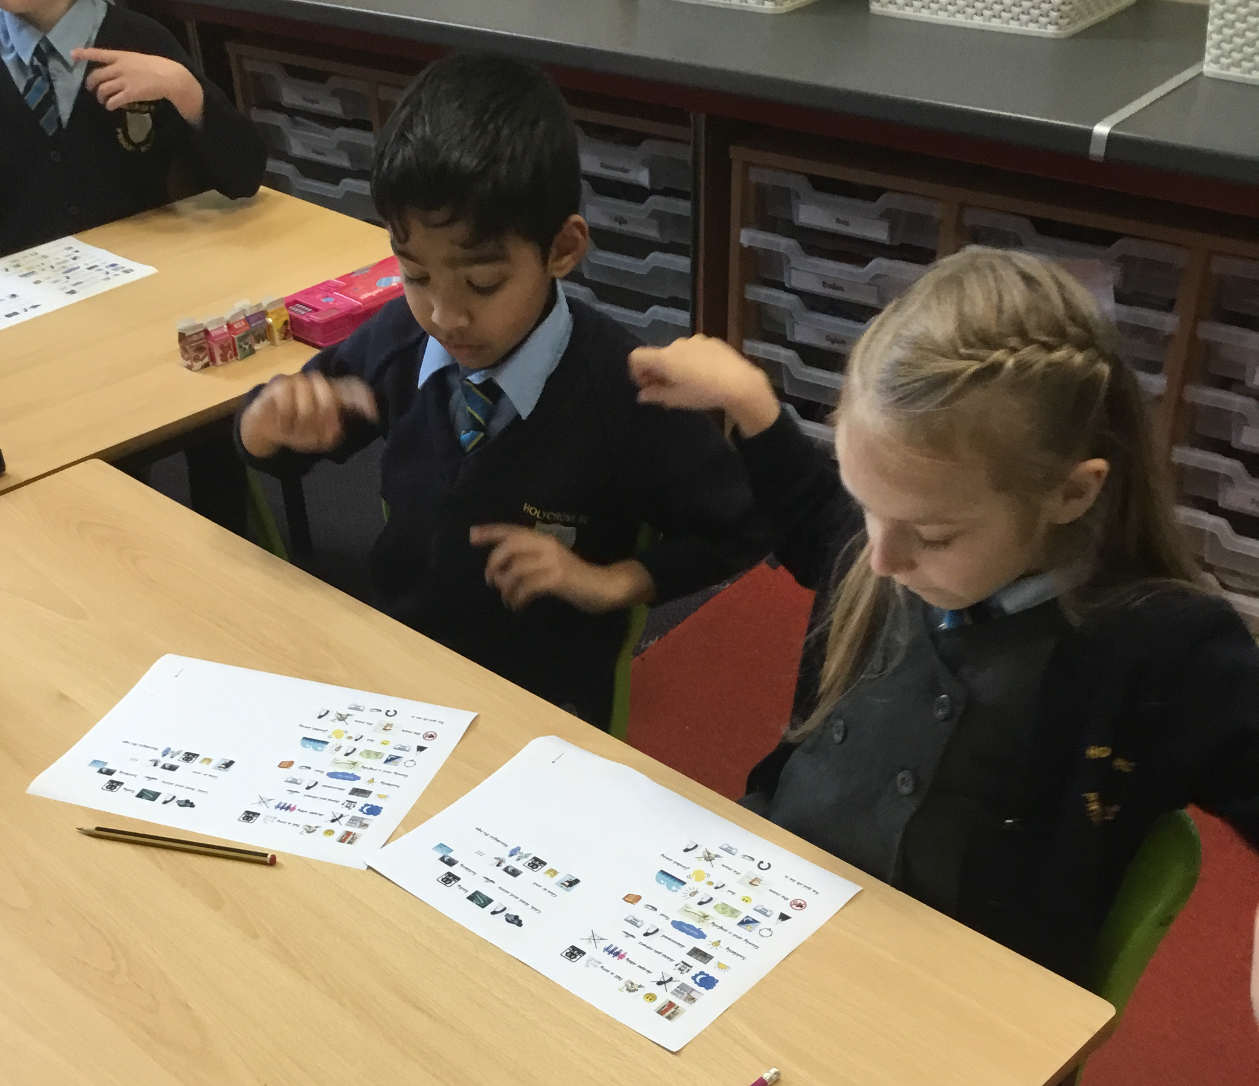
Home/School
Partnership
It is school policy that children have joined handwriting. We believe that writing is important not only in English lessons, but across the breadth of the curriculum.
The ‘Big Write’
Reading regularly boosts writing!
Encourage children to write at home:
Film reviews
Stories
Instructions
Biographies
Diaries
Newspaper articles
Poetry
Writing

Slide 7
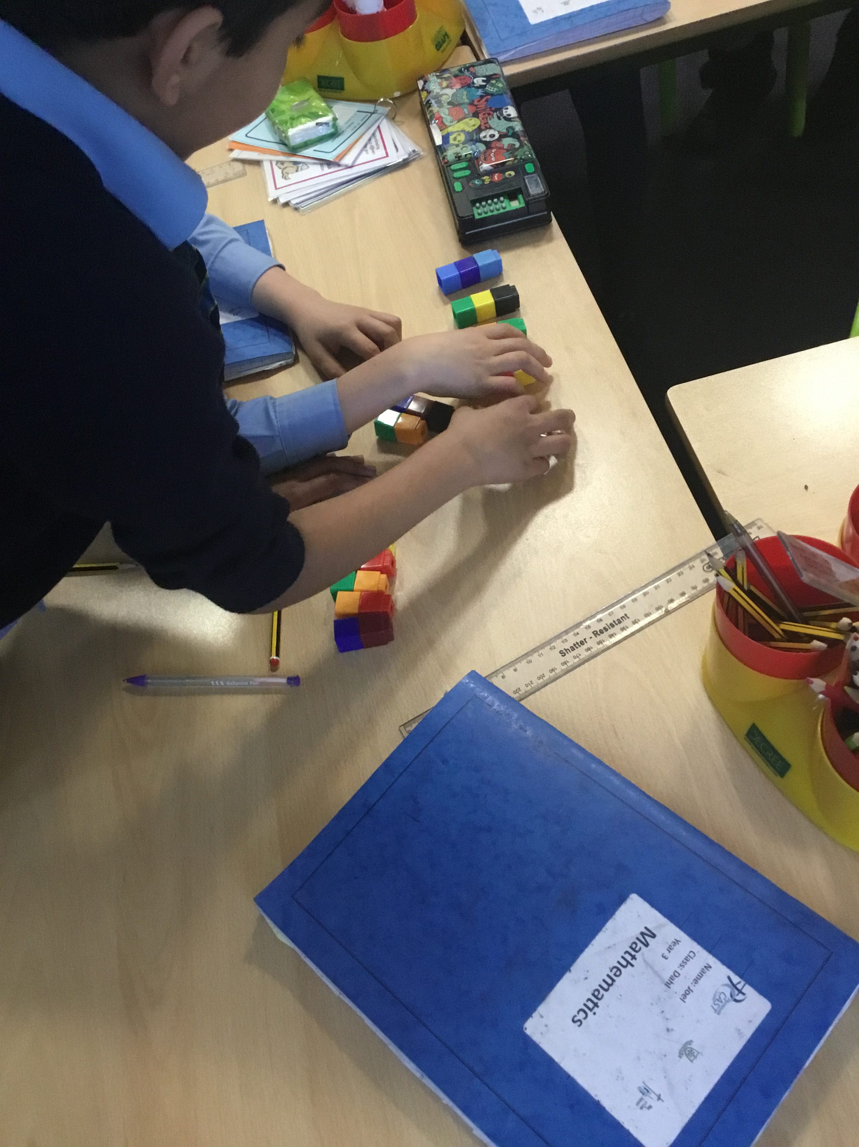
Home/School
Partnership
Play games involving dice and encourage children to count and look for patterns
Encourage children to show you methods they have been learning in school
Ask children to help you measure things at home (could be for a recipe or using a tape measure etc.) and ask them
LOTS of questions:
Which is bigger? Which is smaller? Which do you think weighs more? How many minutes until..? What time is it? I have ‘x’ amount of money. Can I buy ‘this’ and ‘that’? What shapes can you see? How do you know it is that shape? Why is 3 x 4 more than 2 x 4? Can you help me measure this? What did you learn in school today? Can you show me which method you used? How does it work?
https://ttrockstars.com
https://www.topmarks.co.uk/maths-games/hit-the-button
https://mathsbot.com/#Manipulatives
Maths

Slide 8
Behaviour/Expectations
To ensure that children have a safe, settled and enjoyable year, our expectations are very clear and consistent.
We expect the children to be proud of their learning and show this by presenting their work well (home learning and work completed in school).
We expect children to be wearing the correct school and PE uniform.
We expect children to respect everyone in school: all adults and other children.
We expect reading folders, log books and reading records in each day.
All children are star learners when they walk in each morning. The behaviour policy will be used alongside Class Dojo to reinforce positive behaviours and deter negative behaviours.

Slide 9
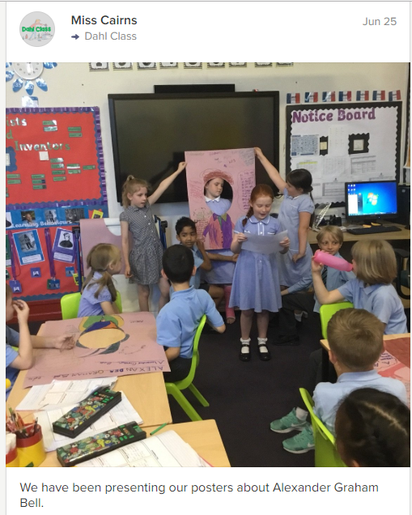
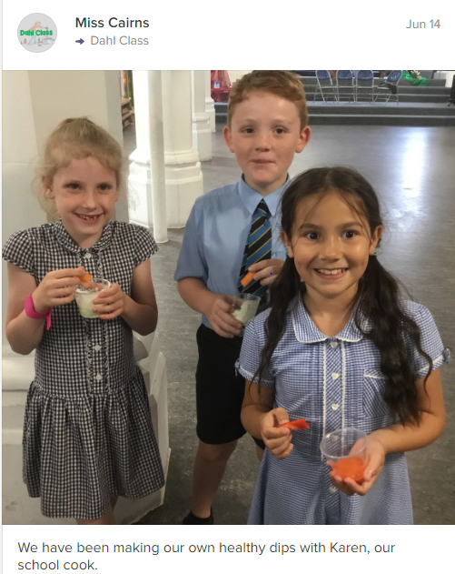
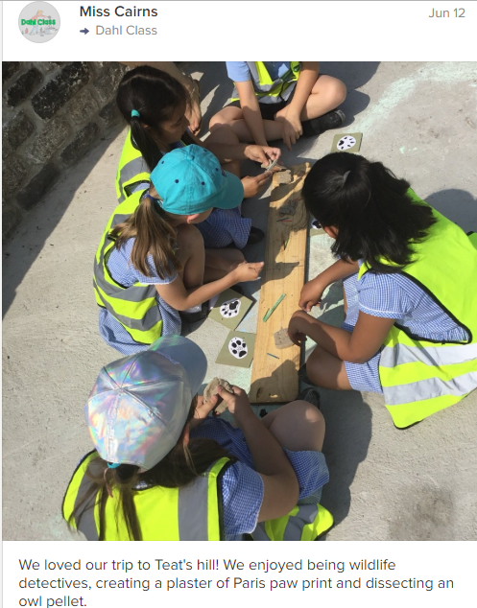
The Dahl Dojo Class Story
After the summer holidays, you will be able to access the Dahl class story. Here you will be able to see what the children are getting up to.We really enjoy seeing parents interact with Dojo so please like and comment on our posts.

Slide 10
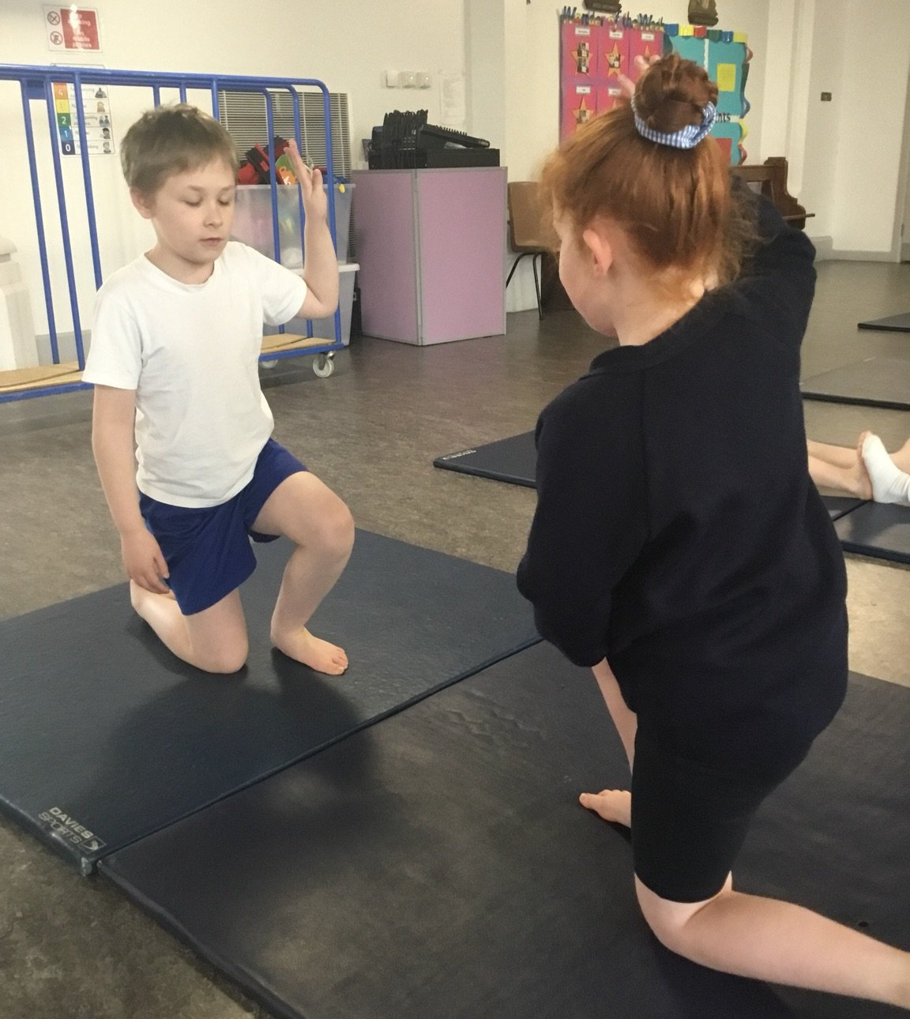
Support and Challenge
Our aim throughout the school is to ensure that the children are given the support they need to become independent, inspired learners with aspirations for the future.
To achieve this we ensure that every child receives:
-High quality teaching from all members of staff
-Immediate in-class intervention
-Additional, short term, small group intervention
-Extra curricular opportunities
- Pre-teaching during early morning time

Slide 11
PE kit
Reading folders and log books to be in everyday
Children should read to an adult daily and this should be signed in their reading records
Water bottles
Waterproof coat
Top up ParentPay for school lunches if necessary

Slide 12
Home Learning
Home learning booklet
Homework club
Daily spellings recorded in their log books
Reading to an adult at home can be recorded in the reading record
Regular practice on
TT Rockstars
Hit the Button
Literacy Planet

Slide 13
Get Involved!
As reading is one of our main focuses this year, we would really appreciate any volunteers to listen to readers in school.
We would also appreciate you sharing any other skills you may have to enrich our learning, for example gardening, sewing etc.
As safeguarding is such a priority, any volunteers would need a DBS check through the school. Please see Mrs Leach or Mrs Rosevear about this if you would like to volunteer.

Slide 14
Useful Websites
Doodlemaths app - this does require a subscription that will cost you £2.99 for a year.

Slide 15
Contact us
We are always here to answer any queries or help you with any concerns as best we can. If you would like to contact us please use the following avenues:
Email – acairns@holycross.plymouth.sch.uk
In September: achantler@holycross.Plymouth.sch.uk
Arrange a meeting after school – contact me via email, Class Dojo or at the end of the school day.
Unfortunately, teachers are unavailable in the mornings as we are busy in class with children from 8.30. Any urgent messages can be passed on through staff on the door.

Slide 16
Marking Policy
Purple Polishing Pen
Children feed back to one another often against clear criteria
Children are encouraged to keep a log/track of their next steps in reading, writing and mathematics
Children are encouraged to talk about their progress and what they need to do next
Feedback from adults will be immediate and verbal wherever possible
All written feedback must indicate clearly how to improve
We encourage children to learn from their mistakes. Sometimes if we place too much emphasis on getting it right the first time round, children can become too nervous to have a go. To help children feel comfortable in the learning environment we use the purple polishing pen. This system allows children to indicate where they have edited their work or responded to teacher feedback. This is a great way to develop editing skills.

Slide 17
Thank you!
Please feel free to stay behind if you have any questions.

