Slide 1
Our theme this week is
GATHER

Slide 2
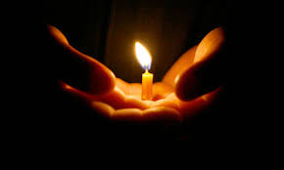
Peace be with you
AND WITH YOUR SPIRIT
We light our candle to remind us of Christ’s presence with us as we gather
+In the name of the Father…

Slide 3
HYMN

Slide 4
Lord Jesus, you ask us to …
For the times we have …
Lord have mercy. LORD HAVE MERCY
Lord Jesus, you ask us to…
For the times we have…
Christ have mercy. CHRIST HAVE MERCY
Lord Jesus, your way is…
For the times we have…
Lord have mercy. LORD HAVE MERCY

Slide 5
Opening Prayer
AMEN

Slide 6
We now stand to welcome God’s word among us.
Praise to you O Christ our Saviour,
word of the Father calling us to life.
Son of God, who leads us to freedom,
glory to you Lord Jesus Christ.
LISTEN

Slide 7
Gospel Reading

Slide 8
Time for us to reflect on our Gospel:

Slide 9
Action or response to the Gospel

Slide 10
In the week ahead let’s…
GOING FORTH

Slide 11
Closing Prayer
THANKS BE TO GOD.

